Slide 1

1- FUND SOLUTIONS 2- THE CONVICTION LIST 3- A FEW PAYOFF 4- NXS MOMENTUM STARS
13th October 2016 – FINANCIAL ENGINEERING
AGENDA

Slide 2
1- FUND SOLUTIONS
13th October 2016 – FINANCIAL ENGINEERING

Slide 3
13th October 2016 – FINANCIAL ENGINEERING
FUND SOLUTIONS
Why does it makes sense to invest into funds ?
Funds tend to
Outperform equity benchmarks in the long run
Offer insulation against the downside risk and provide controlled portfolio volatility
Generate alpha while monitoring the beta
Aim at providing absolute performance returns, regardless of market conditions
Offer returns that are uncorrelated to traditional asset classes
Exhibit an alignment of interests between external investors and Fund stakeholders
Funds in today’s context
In an investment world with “negative cash”, “negative bonds”, potentially fair valued equities, rising volatility, can investors still only stick to traditional investment solutions?
Selecting Funds adequate to your investment objectives and risk appetite is worth contemplating

Slide 4





13th October 2016 – FINANCIAL ENGINEERING
FUND SOLUTIONS
Why does it makes sense to invest into funds ?
- Most investors are familiar with funds
- Investors often like the idea of « a pilot flying the plane » when talking to Fund managers
- The Fund investment strategy enhances the global sales pitch
- Investors usually seek for the right payoff to optimize the Fund exposure through
PROVIDE OPTIMIZED EXPOSURE TO FUNDS

Slide 5
13th October 2016 – FINANCIAL ENGINEERING
FUND SOLUTIONS
What type of payoffs for which funds ?
From an investor perspective: optimize the fund exposure
Leveraged exposure
Total or partial principal protection
- From a regulatory perspective: constraints linked to Volcker Rule in the US
No exposure linked to a (i) fund sponsored by an affiliate ( e.g. NGAM) (ii) a Hedge Fund
From a trading perspective: mostly vanilla payoff
Liquidity and delta adjustment (gamma) constraints
Vega management (likely to lead to volatility control type of mechanism)
No payoff with discontinuity (e.g. digit) except in case of liquid enough ETFs
No short exposure (except in case of liquid enough ETFs)
Subject to the underlying fund beeing vetted internally
Internal guidelines include minimum AUM and global cap on maximum aggregated delta exposure
Section 13 of the Bank Holding Company Act of 1956, as amended (the “Volcker Rule”), introduced in the Dodd-Frank Act,³ generally “prohibits any banking entity from engaging in proprietary trading or from acquiring or retaining an ownership interest in, sponsoring or having certain relationships with a hedge fund or ...
SOME REGULATORY AND HEDGING CONSTRAINTS TO CONSIDER

Slide 6


13th October 2016 – FINANCIAL ENGINEERING
FUND SOLUTIONS - Examples of recent achievements
FUND SOLUTIONS
Examples of recent achievements
INVESTMENT SOLUTIONS
2016 - Europe
2015 - Asia
2015 - Asia
2015 - Europe
3Y 100% capital protected note linked to a basket of 4 long/short Equity Funds
Delta one fund linked
certificate issued by
Violet SPV
OTC call option linked to
a low volatilty basket of 4 Funds
1Y certificate linked to enhanced performance (x2) of UCITS Funds
USD 35,000,000
EUR 100,000,000
EUR 20,000,000
EUR 10,000,000
Corporate
Asia
Large Asian Bank
Family Office

Slide 7
2- THE CONVICTION LIST
13th October 2016 – FINANCIAL ENGINEERING

Slide 8
THE CONVICTION LIST
13th October 2016 – FINANCIAL ENGINEERING
-Well known Fund / asset management companies
Blackrock, JP Morgan AM, DB AM, Nordea Investment Funds, etc…
-Funds with large enough AUMs
-Variety of investment themes and asset classes
Equity Market Neutral
Equity Long Short
Fixed Income
Global fixed Income 80% High yield
Mixed Equity and Fixed Income Allocation
- Geographical investment diversification
Europe
US
Global
-Internal vetting process already completed
A LIST OF 20 MUTUAL FUNDS SELECTED BY NATIXIS
GOOD STARTING POINT FOR PRODUCT PITCH

Slide 9
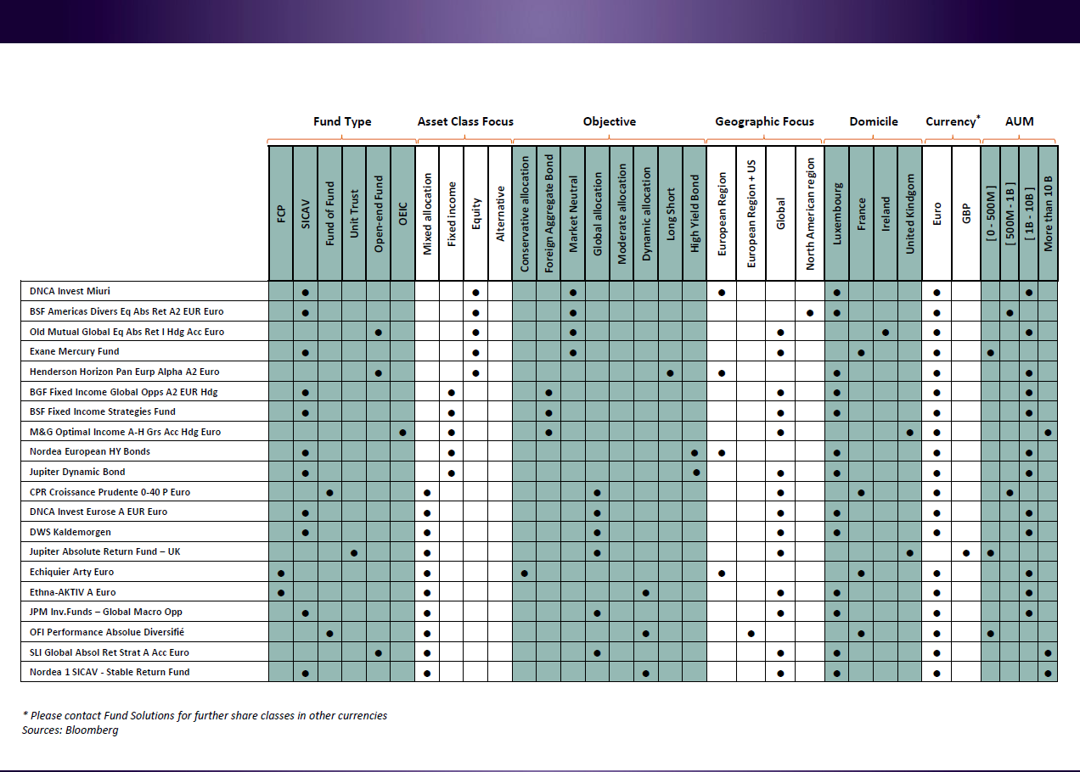

13th October 2016 – FINANCIAL ENGINEERING
Source: Bloomberg
This document is for discussion and information purposes only. It is highly confidential and it is the property of Natixis.
It should not be transmitted to any person other than the original addressee(s) without the prior written consent of Natixis.

Slide 10
3- A FEW PAYOFF
13th October 2016 – FINANCIAL ENGINEERING

Slide 11
13th October 2016 – FINANCIAL ENGINEERING
 | OFFENSIVE
What ? | 2x Leverage Note with | Enhanced Capped Note: 400% x Call Spread 100/102.5-200%x Put Spread 100/50 | Turbo: 200% OTM Call – 100% x Put ITM
Rationale | 2x upside & 2x downside minus borrowing cost with a stop loss | 4 x upside up to a Cap & 2x downside | 2x Upside & 1x Downside
Payoff
 | DEFENSIVE
What ? | Call OTM
Rationale | 100% Capital Protected + upside OTM
Payoff
This document is for discussion and information purposes only. It is highly confidential and it is the property of Natixis.
It should not be transmitted to any person other than the original addressee(s) without the prior written consent of Natixis.

Slide 12
4- NXS MOMENTUM STARS
13th October 2016 – FINANCIAL ENGINEERING

Slide 13
NXS MFS ER Index
Investment Objective
NXS MFS ER Index follows a robust dynamic rule-based strategy:
which aims to capture momentum across a diversified portfolio of funds invested in diverse asset classes;
with an attractive risk - return profile;
which is simple and transparent.
The Fund managers objectives included in the Index have allowed them to provide:
Diversification
Via different strategies, regions, asset classes (i.e bonds, equities, credit, foreign exchange) and different management styles.
Stable Returns
Obtain positive and stable returns over long-term.
Correlation
Underlying funds are each invested in different asset classes among which correlations are low.
Risk Control
Liquidity/Transparency
Through a Protection Methodology designed to limit negative performance in extreme market conditions.
Fully transparent underlying funds with daily liquidity.

Slide 14
NXS MFS ER Index
Components
The NXS MSF ER Index provides exposure to a basket of five attractive funds:
Well regarded funds in their markets.
Considerable asset under management.
Robust performance history of the Index.
Funds with daily liquidity.
Tested through different market conditions.
Old Mutual – Equity Absolute Return Fund
Nordea 1 - Stable Return Fund
M&G Optimal Income Fund
Nordea 1 - European High Yield Bond Fund
PIMCO Emerging Markets Bond Fund

Slide 15
Momentum
Rationale and Methodology
Rationale
Boasts simple rules which go long funds with strong returns adding significant value over time.
Utilises trend-following strategies which have the potential to provide diversification on downside risk events with negative correlation to equities.
Offers allocation amongst diversified funds covering different regions, asset classes and instruments which exhibit strong momentum and provide diversification, creating value.
Methodology
Every two months on the last business day of the month, the strategy is dynamically rebalanced as follows:
The Funds are ranked according to their previous 2-months performance in order to determine their weightings for the next 2 months.
50%
Best Performing
25%
Second Best Performing Fund
12.5%
Third Best Performing Fund
12.5%
0%
Fourth Best Performing Fund
Fifth Best Performing Fund

Slide 16
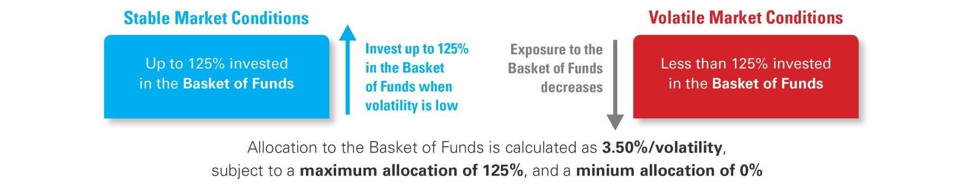
NXS MFS ER Index
Characteristics
Composition
The Index is based on a daily risk adjustment of the portfolio of the five Funds where the weightings of each Fund are defined on a bi-monthly basis.
The Index has the following characteristics:
Exposure: NXS MFS ER Index provides exposure to the Excess Return Performance of the selection of funds, less the cost of borrowing necessary to achieve the exposure, less the Index costs.
Excess Return: meaning that the Index reflects the performance of the Basket of Funds above the risk-free rate.
Risk Control: Volatility Target Mechanism aiming to keep the volatility as close as possible to 3.50%.
Certain costs are deducted from the level of the Index, they cover: running of the Index, publication of the Index, replication, volatility control and repurchase agreement costs.

Slide 17
Historical Performance
Between 29 October 2009 and 07 September 2016.
Past performances relate to past periods and are not a reliable indicator of future performances.
NXS Momentum Fund Stars ER Index
Inception date | Annualised Performance | Cumulative Performance | Annualised Volatility | Sharpe Ratio | Max drawdown | Time to recovery
02/11/2009 | 7.13% | 60.34% | 3.44% | 2.07 | -5.53% | 253D
Source: Natixis

Slide 18
8. Index Performance
VS. MSCI World Index
Year to date performance
Past performances relate to past periods and are not a reliable indicator of future performances.
NXS Momentum Fund Stars ER
+7.22%
+2.97%
MSCI World®
Source: Natixis, Bloomberg

Slide 19
9. Key Metrics
Between 02 November 2009 and 7 Sep 2016.
Past performances relate to past periods and are not a reliable indicator of future performances.
Key benchmark Risk/Return
HFRXGL
NXS MFS ER
The monthly return distribution highlights a positive skew and very stable returns.
Close to 70% of the past monthly returns were positive.
Benchmark | Annualised Performance | Annualised Volatility | Sharpe Ratio
NXS MFS ER | 7.05% | 3.45% | 2.07
S&P 500 | 11.30% | 16.37% | 0.70
iShares MSCI Emerging Markets | -0.41% | 23.83% | -0.02
HFRX Global Hedge Fund Index | 0.64% | 3.54% | 0.18
SPDR® Gold Trust | 2.87% | 18.18% | 0.16
Source: Natixis

